Slide 1
Searching an array

Slide 2
Outline
In this lesson, we will:
Review the algorithm for searching an array
Discuss the run-time associated with such a search

Slide 3
Searching an array
Recall our algorithm for searching an array:
std::size_t linear_search( double const array[],
std::size_t const capacity,
double const sought_value ) {
for ( std::size_t k{0}; k < capacity; ++k ) {
if ( array[k] == sought_value ) {
return k;
}
}
return capacity;
}

Slide 4
Searching an array
Recall our use of const:
std::size_t linear_search( double const array[],
std::size_t const capacity,
double const sought_value );
Under no circumstances should an array change
the value being sought after
the entries of the array
the capacity of the array

Slide 5
Searching a sub-array
Suppose we only want to search a sub-array within an array:
For example, we want to search from index 3 up to index 9
In this case, we should pass both indices:
bool linear_search( double const array[],
std::size_t const begin,
std::size_t const end,
double const sought_value );

Slide 6
Searching a sub-array
Initially, the implementation would probably look as follows:
std::size_t linear_search( double const array[],
std::size_t const begin,
std::size_t const end,
double const sought_value ) {
for ( std::size_t k{begin}; k < end; ++k ) {
if ( array[k] == sought_value ) {
return k;
}
}
return end;
}
We are searching from array[begin] to array[end - 1]

Slide 7
Is a sub-array sorted?
Why not search up to array[end]?
In C++, loops generally are understood to
Start at one value (in this case, begin)
Go up to, but do not include, a second value (in this case, end)
Use the approach that is ubiquitous to the community that uses the programming language used
Otherwise, it identifies you as a novice or naïve programmer
Example: in Matlab, you would search from begin to end, inclusive

Slide 8
Searching a sub-array
Note that we can now implement the function by calling the other:
// Search an array with 'capacity' entries
std::size_t linear_search( double const array[],
std::size_t const capacity,
double const sought_value ) {
return linear_search( array, 0, capacity, sought_value );
}
Do not re-implement similar code if you do not have to
This simplifies maintenance, debugging, and life in general

Slide 9
Run time
This algorithm steps through the array entry by entry
It is usually described as a linear search
Suppose that this algorithm takes 2 μs to search an array of with a capacity of 1000
Question: How long, approximately, would it take to search an array with a capacity of 500? 2000? 10 000?
Why?

Slide 10
Searching an array
We are not making any assumptions about the array:
The entries may be completely random
Consequently, information about a current value may not allow us to infer were to look
For example, if array[0] == 1073741823, this tells us nothing about the value stored in array[1]

Slide 11
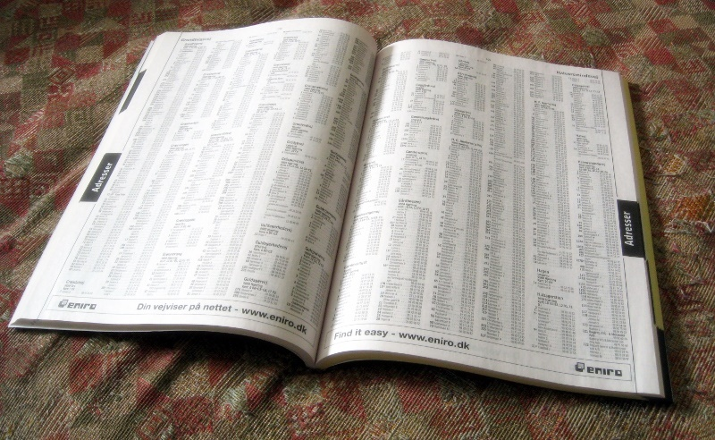
Searching an array
Suppose, however, you were looking up the name Sashdeva in the telephone book
Would it ever make sense to use a linear search?
The assumption is that the phone book is alphabetically ordered
Tomasz Sienicki

Slide 12
Searching an array
This was not always true:
The first phone book required a linear search
Rev. JOHN E. TODD. J. B. CARRINGTON. H. B. BIGELOW. C. W. SCRANTON. GEORGE W. COY. G. L. FERRIS. H. P. FROST. M. F. TYLER I. H. BROMLEY GEO. E. THOMPSON. WALTER LEWIS. Physicians. DR. E. L. R. THOMPSON. DR. A. E. WICHELL. DR. C. S. THOMSON, Fair Haven. Dentists. DR. E. S. GAYLORD. DR. R. F. BURWELL. Miscellaneous. REGISTER PUBLISHING CO. POLICE OFFICE. POST OFFICE. MERCANTILE CLUB. QUINNIPIAC CLUB. F. V. McDONALD, Yale News. SMEDLEY BROS. & CO. M. F. TAYLER, Law Chambers. | Stores, Factories, &c. O. A. DORMAN. STONE & CHIDSEY. NEW HAVEN FLOUR CO. State St. “ “ “ “ Cong. ave. “ “ “ “ Grand St. “ “ “ “Fair Haven. ENGLISH & MERSICK. New Haven FOLDING CHAIR CO. H. HOOKER & CO. W. A. ENSIGN & SON. H. B. BIGELOW & CO. C. COWLES 7 CO. C. S. MERSICK & CO. SPENCER & MATTHEWS. PAUL ROESSLER. E. S. WHEELER & CO. ROLLING MILL CO. APOTHECARIES HALL. E. A.GESSNER. AMERICAN TEA CO. Meat & Fish Markets. W.H. HTICHINGS, City Market. GEO. E. LUM. “ “ A. FOOTE & CO. STRONG, HART & CO. Meat & Fish Markets. CRUTTENDEN & CARTER. BARKER & RANSOM.

Slide 13
The Standard Template Library (stl)
Output:
1: array[0] == 1
2: array[3] == 2
4: array[4] == 4
5: array[1] == 5
6: array[6] == 6
7: array[5] == 7
The stl has a linear search algorithm:
#include <algorithm>
// ...
int main() {
int array[10]{1, 5, 5, 2, 4, 7, 6, 2, 4, 5};
for ( int k{0}; k < 10; ++k ) {
int *p_loc{std::search( array, array + 10, &k, &k + 1 )};
if ( p_loc != (array + 10) ) {
std::cout << k << ": array[" << (p_loc - array)
<< "] == " << *p_loc << std::endl;
}
}
return 0;
}
The address of what you’re looking for
followed by the next address
– Pointer arithmetic

Slide 14
The Standard Template Library (stl)
Recall that:
array + 10 is equivalent to &( array[10] )
The second argument is the address one beyond the last entry we intend to search
This entry is never accessed
We can search a sub-array as follows:
int *p_loc = std::search( array + 5, array + 9, &k, &k + 1 );
This search array[5] through array[8]
If nothing is found, array + 9 is returned

Slide 15
Searching an array
In the upcoming lectures, we will
Define an detecting a sorted array
Consider two algorithms for searching a sorted array

Slide 16
Summary
Following this lesson, you now
Know that a linear search is a slow algorithm
You would never use it for searching a phone book
Know that doubling the array capacity will double the time
Understand that if an array is unsorted, you must examine every entry of the array

Slide 17
References
[1] Wikipedia:
https://en.wikipedia.org/wiki/Linear_search
[2] nist’s Dictionary of Algorithms and Data Structures
https://xlinux.nist.gov/dads/HTML/linearSearch.html

Slide 18



Colophon
These slides were prepared using the Georgia typeface. Mathematical equations use Times New Roman, and source code is presented using Consolas.
The photographs of lilacs in bloom appearing on the title slide and accenting the top of each other slide were taken at the Royal Botanical Gardens on May 27, 2018 by Douglas Wilhelm Harder. Please see
https://www.rbg.ca/
for more information.

Slide 19
Disclaimer
These slides are provided for the ece 150 Fundamentals of Programming course taught at the University of Waterloo. The material in it reflects the authors’ best judgment in light of the information available to them at the time of preparation. Any reliance on these course slides by any party for any other purpose are the responsibility of such parties. The authors accept no responsibility for damages, if any, suffered by any party as a result of decisions made or actions based on these course slides for any other purpose than that for which it was intended.

